Slide 1

Working Rite Glasgow

Slide 2

Our Story
We are a charity working with young people aged 15-25 to create
positive choices for what comes next after school.
We build connections with employers and create chances for young people to grow their skills and confidence in working environments.
We are committed to coaching young people, engaging their families, carers and communities over a sustained period to create long-term change through working.

Slide 3
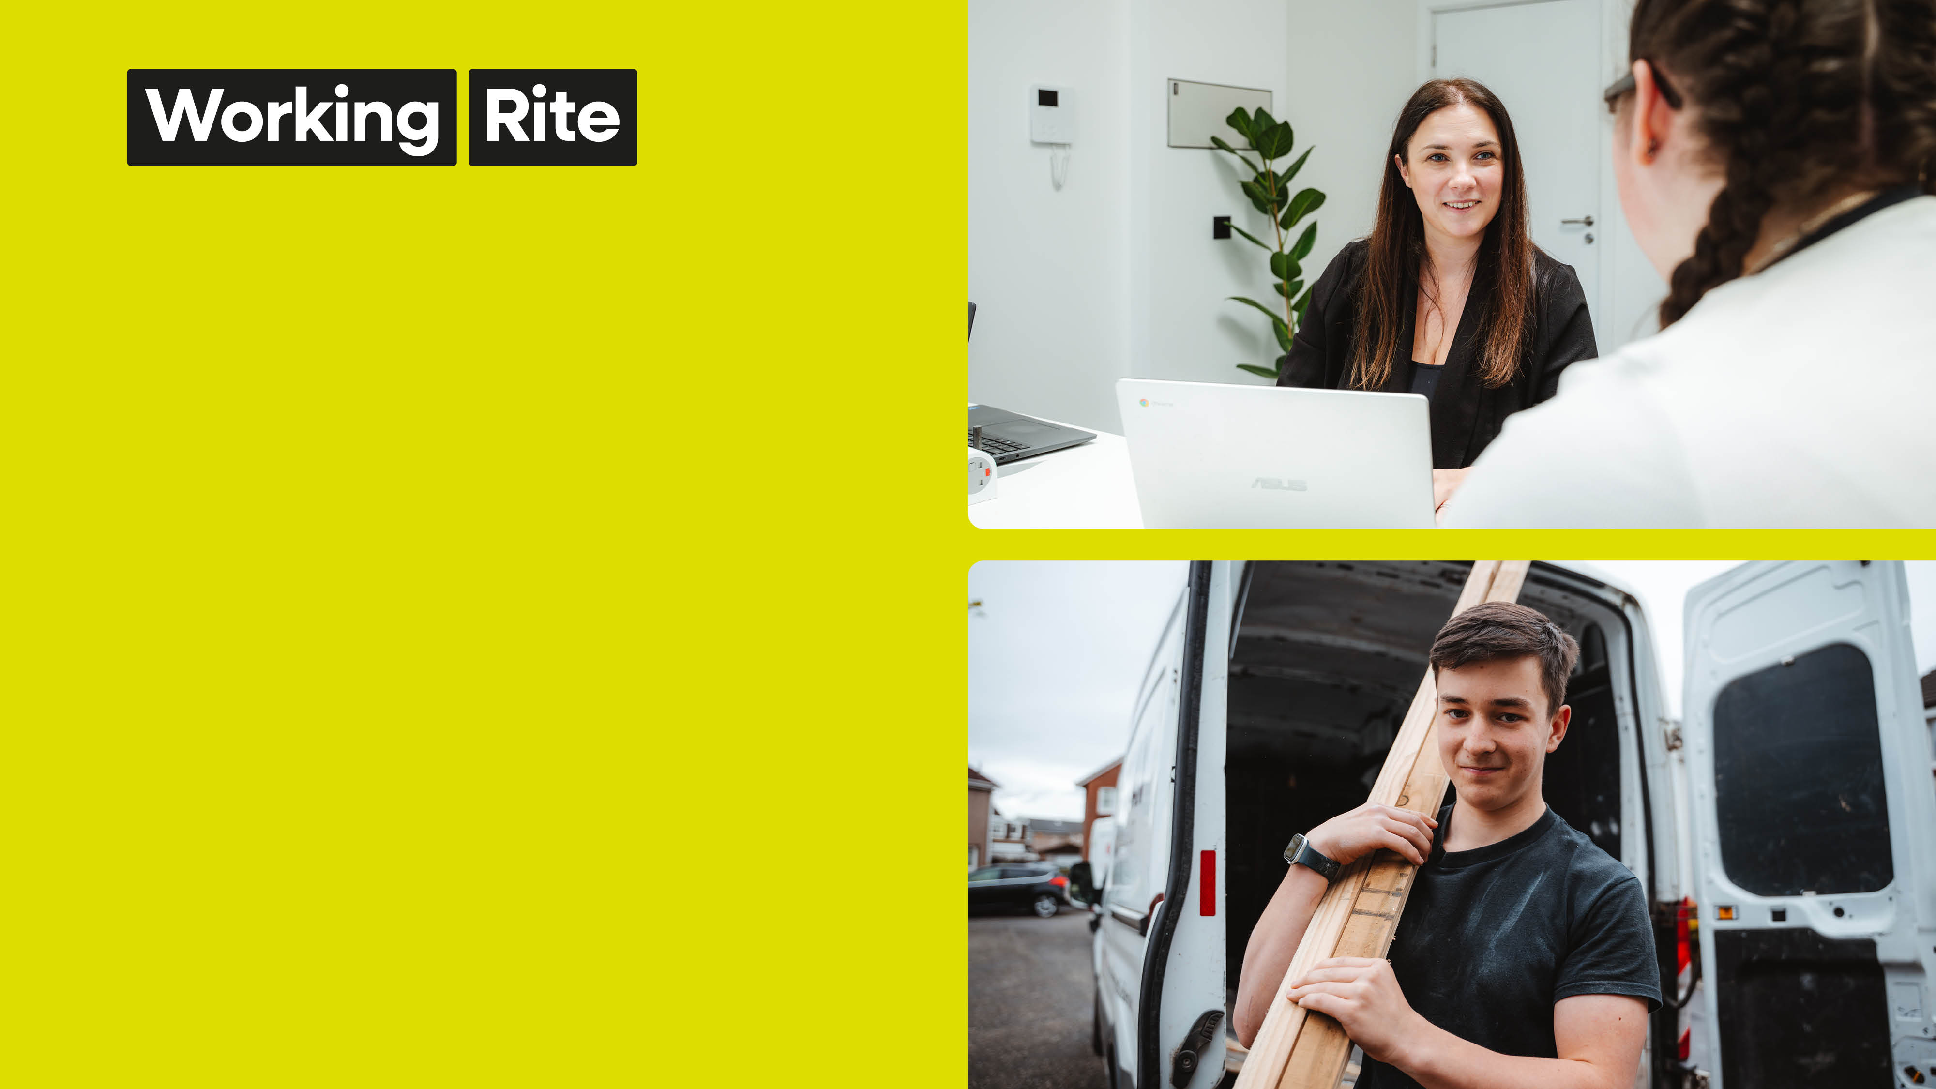
Our Strategic Priorities
Reach young people across Scotland where we are needed most.
Grow the depth of our intervention and impact
Create sustained change that works for our young people

Slide 4

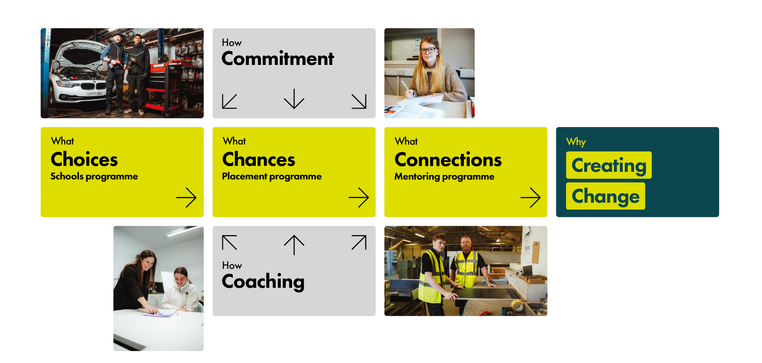
Our Model

Slide 5

How our model works
Choices
(School Age)
Chances
(Work Placement)
Connections
(Mentoring)
S4 Pupils
Full academic year
Once a week
Small groups
Out of school = safe space
Providing choices for school leavers as they start their working lives.
Aged 16+
3–4 month tailored work placements
Young people given chances to grow through work placements, volunteering and vocational training.
12months ongoing support
Gives young people continued guidance during the crucial early stages of working life.
Builds connections that sustain positive impact

Slide 6
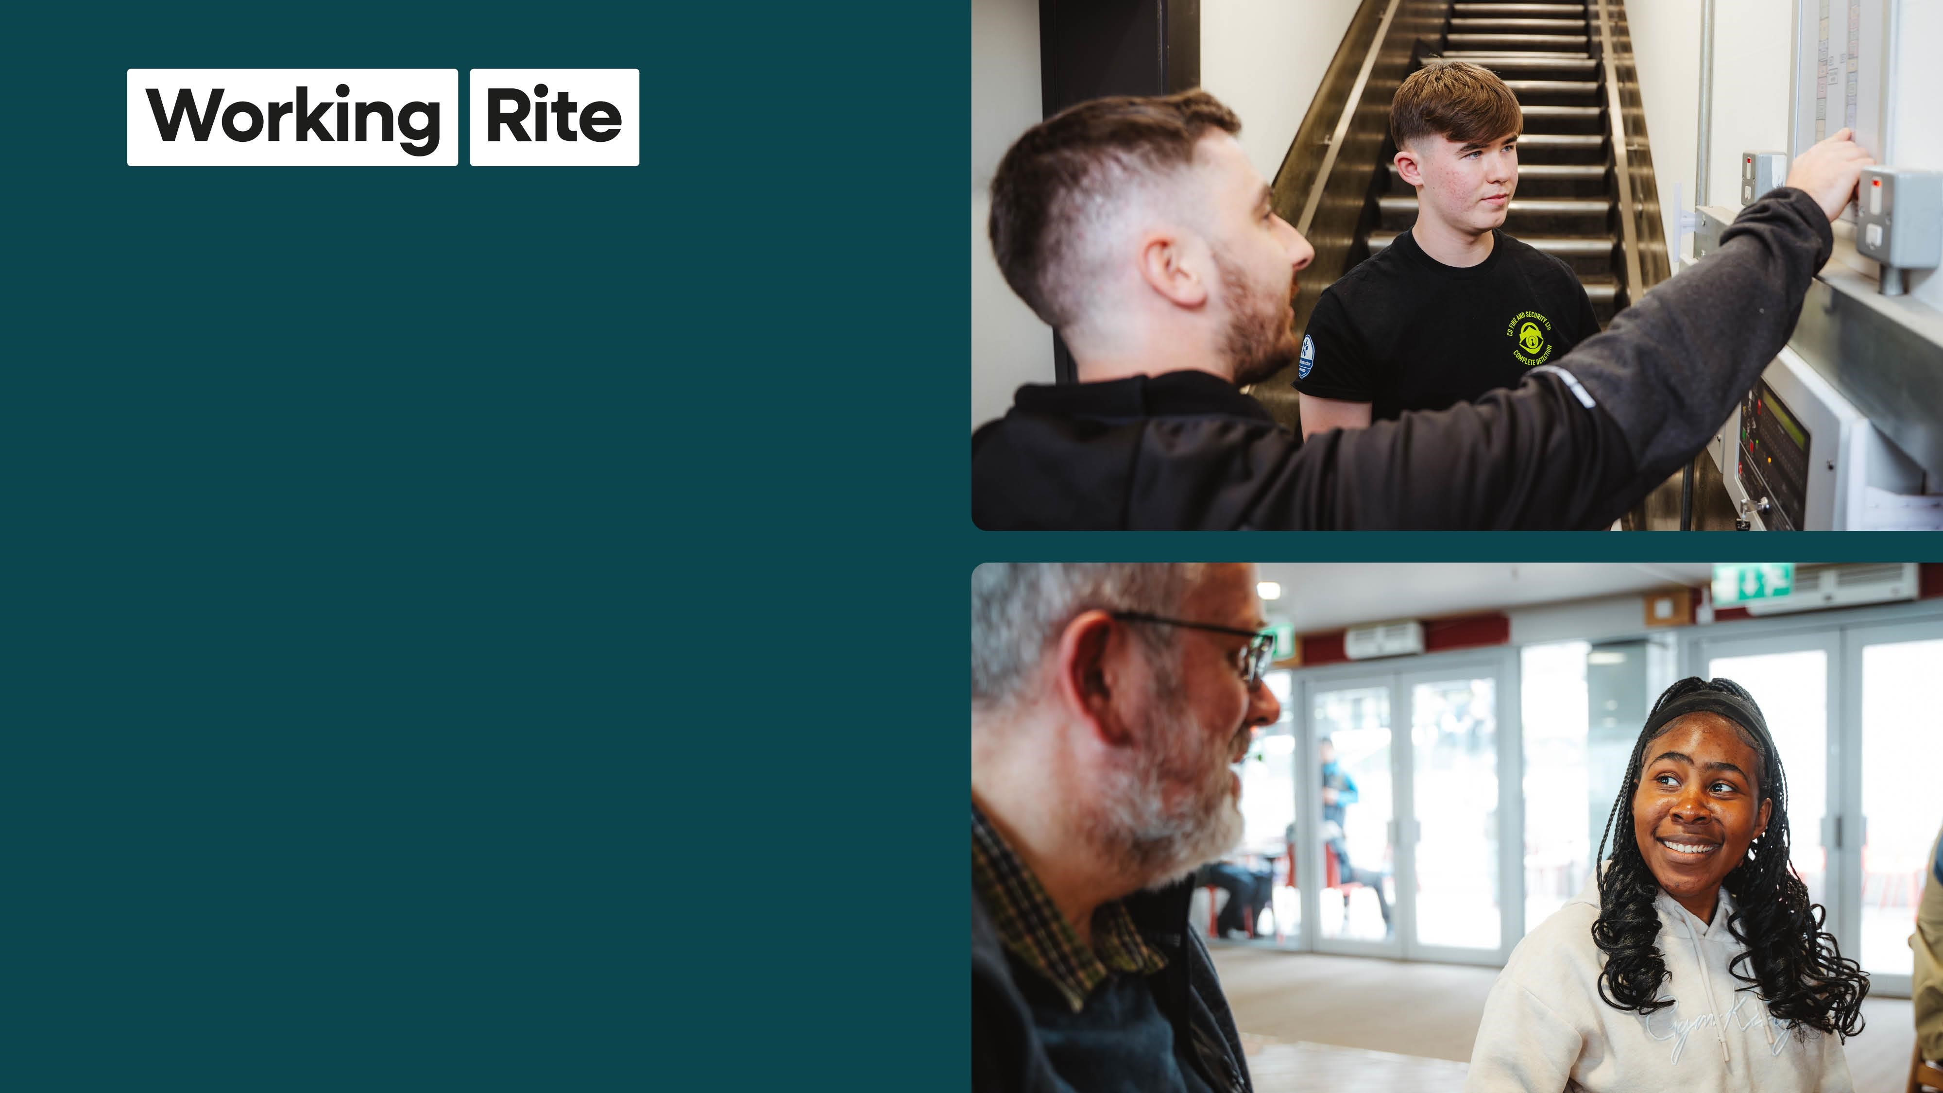
Chances
Programme
(
Induction stage
)
•
4
-
6
Weeks in groups or 1 to 1 support
•
Set goals
•
Build confidence
•
QS Certificate of Work Readiness
•
Prepare for work placement
•
Vocational training
•
Training allowance paid

Slide 7

Chances
Programme
(
Work Placement
)
•
12
week
paid work placement with local
business
•
Training allowance paid £55p/week
Working Rite
–
matched by placement
provider
•
PPE/Travel expenses/Workplace mentor
•
QS Workplace Award
•
Progression to work or further support if
needed
•
Offer of mentor (Connections) on
completion

Slide 8

Summary of provision in Glasgow
1
,208
534
Supported
674
Supported
Individuals
in South
in
North West
supported
Glasgow
Glasgow
Across key projects in
Across partnerships with
Pathfinder programme
North West
Glasgow &
local Housing
delivered in partnership
South Glasgow
Associations:
with DRCYP.
Whiteinch & Scotstoun HA
Glenoaks HA
New Gorbals HA
Queens Cross HA
Network of over 22 referring organisations
Elderpark
HA
l

Slide 9

Placement Employers
617
Community Employers
engaged across Glasgow

Slide 10

Positive Outcomes
–
NW Glasgow
508
into employment, MA or FE
75
% Positive outcomes

Slide 11

Positive Outcomes
–
South Glasgow
374 into employment, MA or FE
70
% Positive Outcomes

Slide 12

How do you get involved
Partnerships
Funding
Young People
Employers
Volunteering
Delivery Partners
Events
Training delivery hub
Joint funding opportunities
Provide direct funding
Community Benefits -subcontractors
Referral young tenants & residents
Placement Opportunities
Site visits
Apprenticeships
Employment opportunities
Mentoring Opportunities
Trustees
Youth Committee

Slide 13
Why Partner with Working Rite
Help local young people get access to jobs, training, and opportunities to build their future
Support better outcomes for tenants by boosting confidence, skills, and independence
Show real commitment to social value and investing back into local communities
Step in early to help break down barriers to employment and improve long-term prospects
Open up routes into work through mentoring and hands-on work experience
Build stronger connections between housing providers, employers, and community organisations
Support key priorities like employability, tenant engagement, wellbeing, and community growth

Slide 14

Contact us
Scott Christie – Head of Development
scott@workingrite.co.uk
Tracey Goslan – Head of Operations
tracey@workingrite.co.uk
Maureen Merrick – Operations Manager
maureen@workingrite.co.uk

