Slide 1
The Value of Kindness

Slide 2
About us

Slide 3
Why is kindness important?
Communities
Organisations
Place
Wellbeing
Power
Loneliness &
isolation
Falling
trust in institutions
Empowerment
Dependence on services
Growing demand for
services

Slide 4
What do we mean by kindness?
Communities
Organisations
Individuals
Systems/ Structures
Relational kindness
Random kindness
Radical
kindness

Slide 5
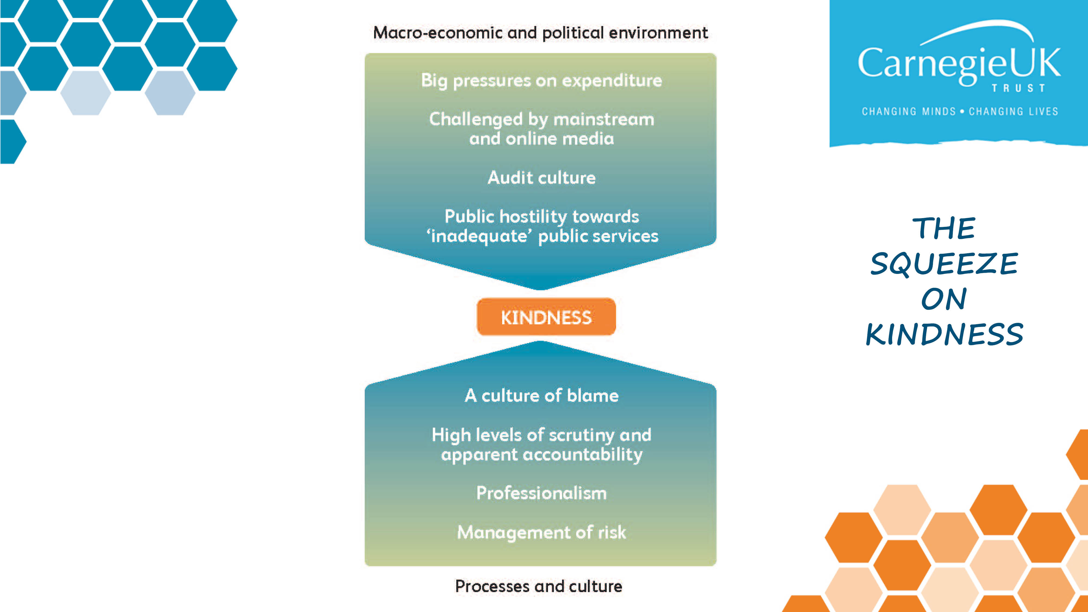

Slide 6
Creating the conditions for kindness
Notes:
In both cases we acted not as observers or evaluators of test projects but as active participants in exploration
Moving from thoughtful discussion to practical tests of change has proved difficult - might want to spend some time thinking about why
What we learned
Examples which prompt informal connections and relationships in communities

Slide 8
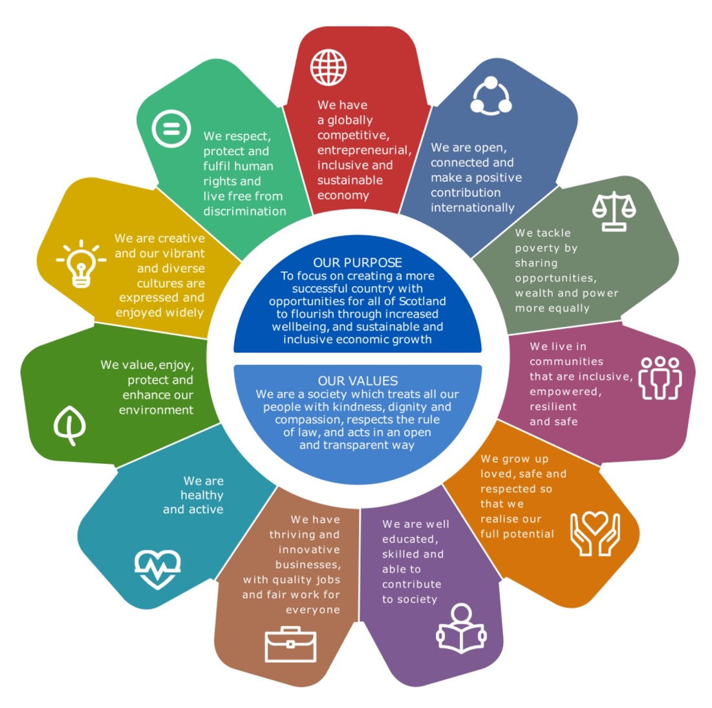
National Performance Framework
http://nationalperformance.gov.scot/

Slide 9
Closing questions…
trusting our staff to make meaningful connections with people
protecting time and creating spaces for people to come together
listening to people’s needs and finding solutions in the round, not just addressing our bit of the picture
creating opportunities to recognise and celebrate kindness
creating a culture where people are more important than processes and enabling unkindness to be called out
ensuring or performance management aligns with our values and committing to ask our staff and those we serve if they experience kindness
What gets in the way of kindness
How can / do housing associations ‘create the conditions for kindness’?
What are the barriers to kindness in existing support services?
What would it take to make kindness feel real?

Slide 10
Discussion
trusting our staff to make meaningful connections with people
protecting time and creating spaces for people to come together
listening to people’s needs and finding solutions in the round, not just addressing our bit of the picture
creating opportunities to recognise and celebrate kindness
creating a culture where people are more important than processes and enabling unkindness to be called out
ensuring or performance management aligns with our values and committing to ask our staff and those we serve if they experience kindness
What gets in the way of kindness
Does this reflect your experience of KIN?
Is anything missing?
What does this report need to say?
What does it need to ask?
Why was it hard to move from conversations to practical change?

