Slide 1

Embracing Neurodiversity in Community Engagement

Slide 2
Agenda
What is neurodiversity?
Spiky profiles
Strengths and challenges
Community engagement: what to consider

Slide 3

What is neurodiversity?
Neurodiversity is the concept that we are all different in terms of our neurocognitive abilities.
We all think, process and experience the world differently.
It covers autism, ADHD, dyslexia, dyscalculia, dyspraxia, dysgraphia, Tourette syndrome and others.
15-20% of the population is neurodivergent.
Notes:
In basic terms, neurodiversity is about how our brains work and recognises that our brains all work differently.
Neurodiversity is the natural neurocognitive variation among human beings.
Neurotypical – dominant style of neurocognitive functioning in a given culture or society.
Neurodivergent – differs from the neurocognitive norms of a given culture or society.
We are all neurodiverse, but some people are neurodivergent.
Collectively, we can refer to neurominorities, neurodivergence. These terms have replaced neurodevelopmental disorder or specific learning disability as umbrella terms, because they are neutral and don’t insinuate ill health.

Slide 4
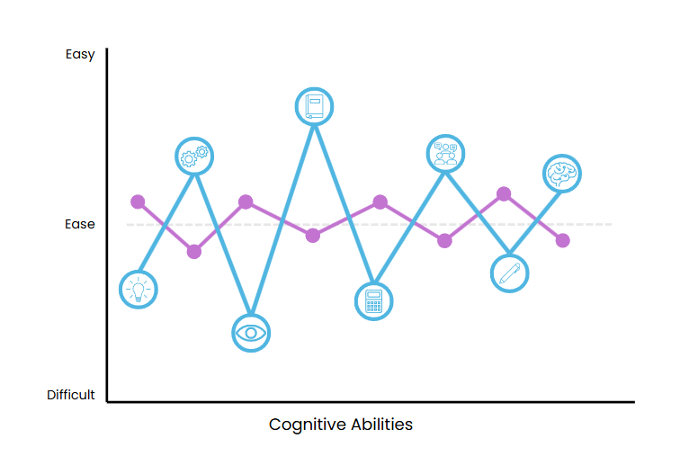
Spiky profiles
Notes:
Spiky profiles are a good way of explaining the differences in ability that are associated with neurodivergence.
Spiky profile : green line is a neurotypical or a generalist thinker. Scoring about the same on most areas of cognition. Purple line is a neurodivergent, with massive differences between their strengths and weaknesses. So a neurodivergent person may find that there are things that they can do far better than their colleagues, but there are also things that they find much harder.
Strengths are likely to be:-
Abstract Reasoning: visual thinking, seeing the bigger picture, noticing patterns or that something doesn't add up, connecting ideas, thinking outside the box.
Verbal Reasoning: ability to ask the right questions. Articulate the point, explain and describe concepts.
Challenges could be:
Memory: struggle to remember what they have heard, working memory e.g. processing a number of thoughts or actions at one time.
Processing Speed: focusing attention: visually scanning and sequencing information, making quick decisions on detailed information in the moment > leads to problems with time management, organisation, planning and prioritising, dealing with distractions
All ND conditions include a spiky profile. Transient conditions – when you are experience anxiety, your working memory/processing speed is lower than normal, but things like creativity / language won’t be affected.
When you have chronic neurodivergence, again, working memory/processing speed is affected, word finding might be affected, but others won’t be.
When you have a developmental neurodivergent condition (applied or clinical) there will be some areas which are always lower than others, for example working memory or language ability, and others that are always higher, such as visual skills or long-term memory.

Slide 5
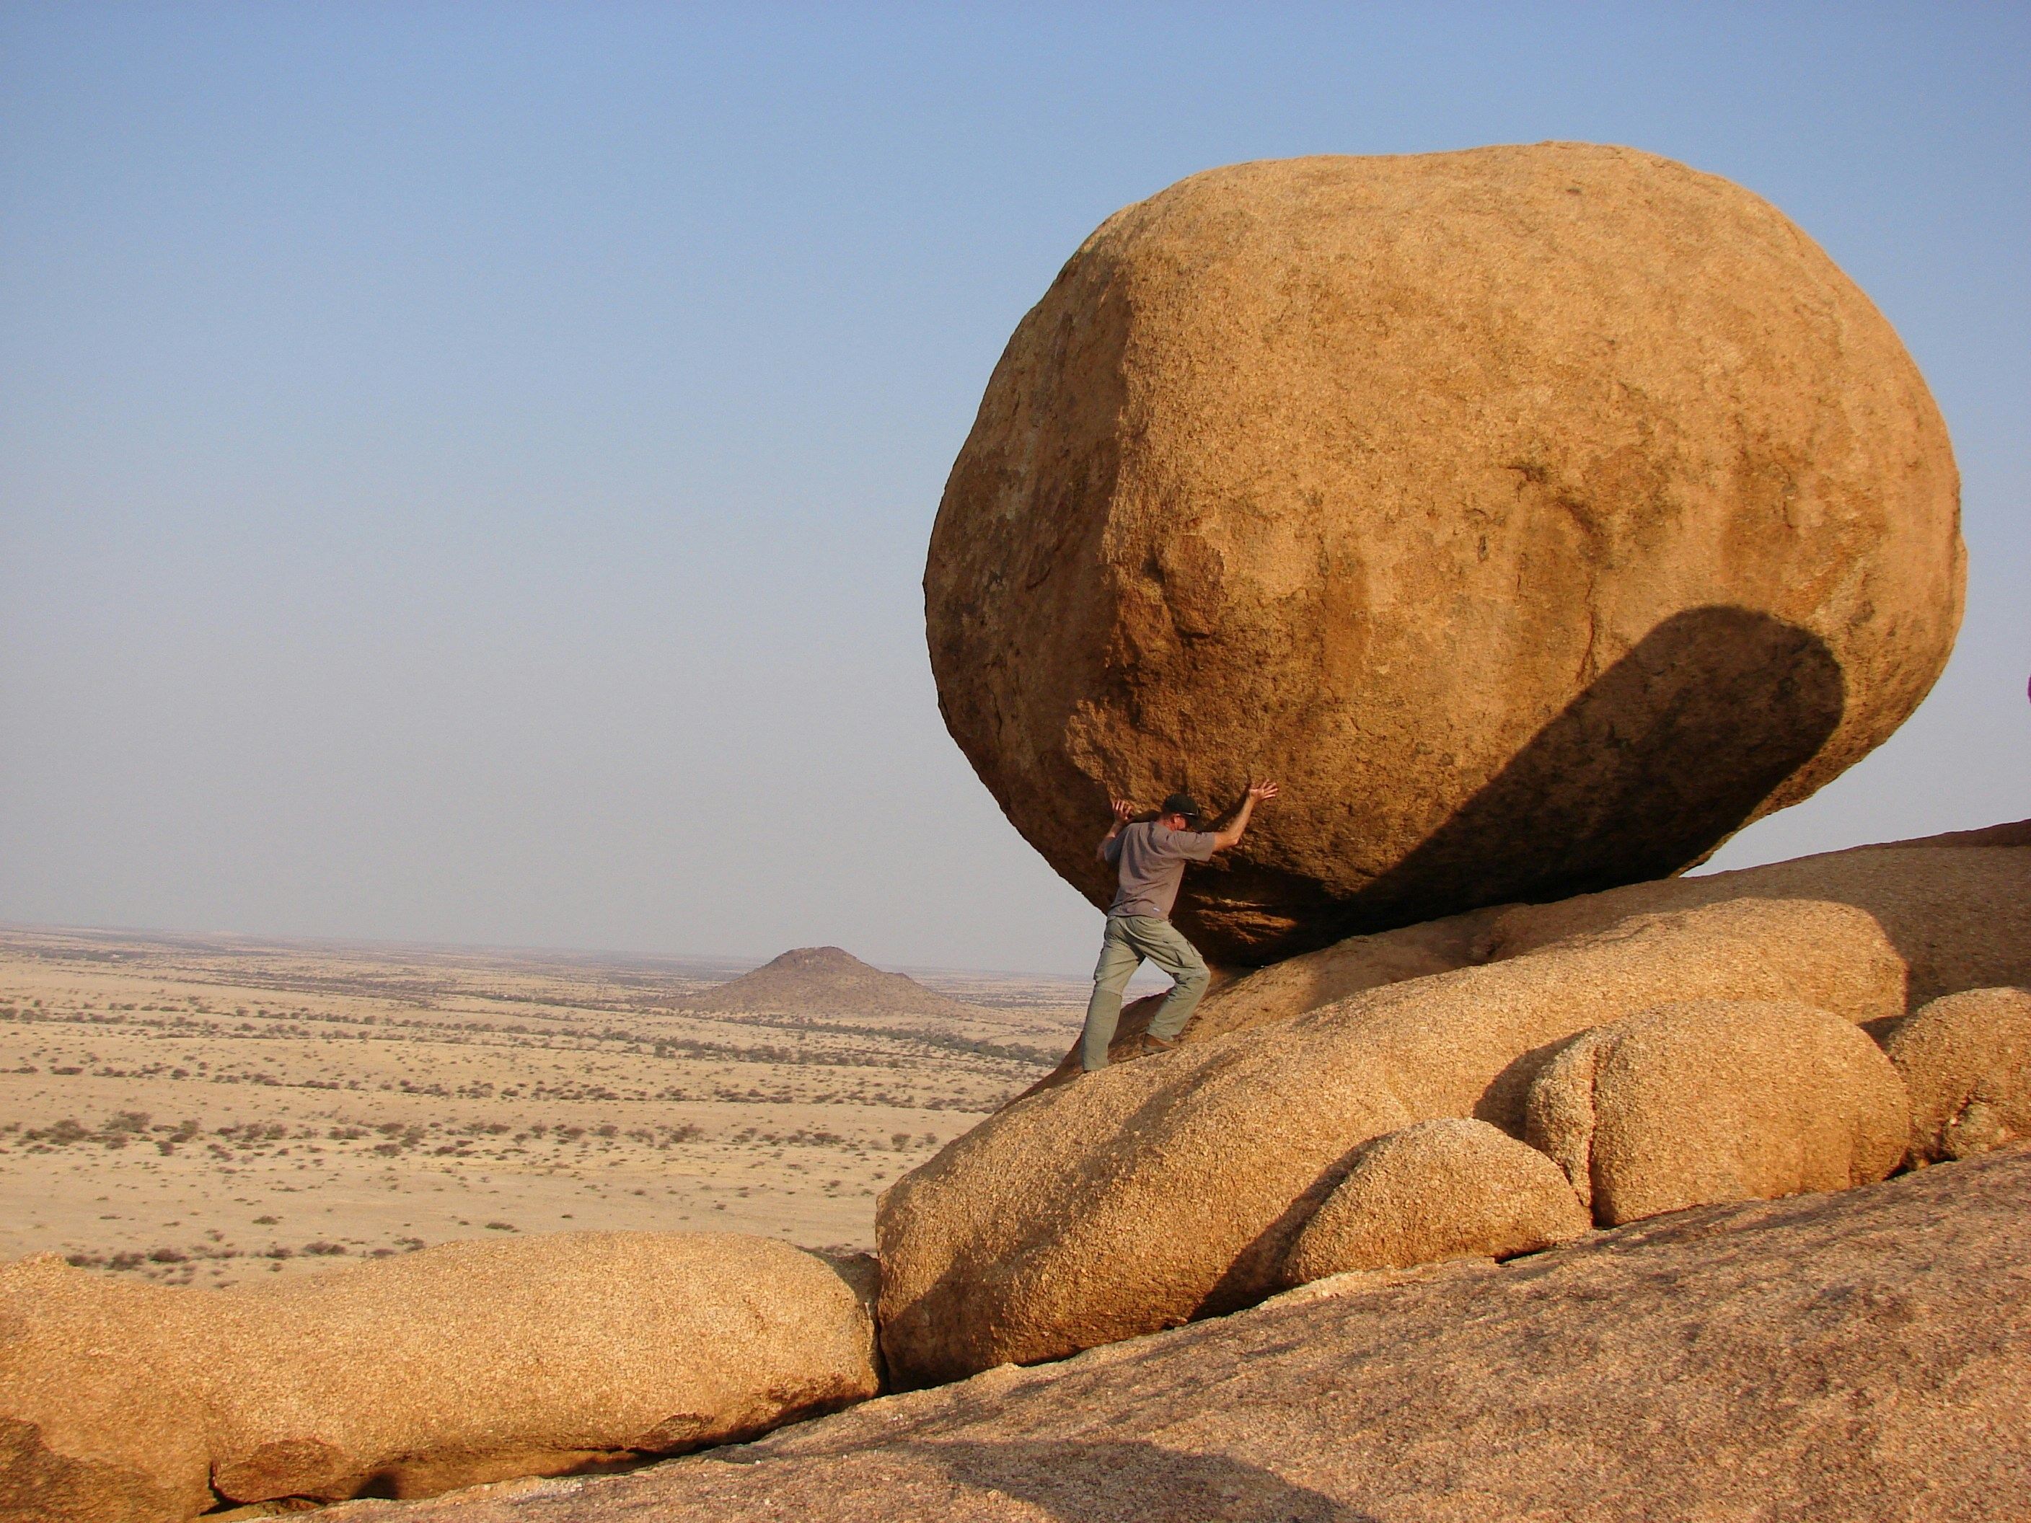
Strengths
Ability to hyperfocus
Passion and enthusiasm
Problem-solving abilities
Creativity and innovation
Tenacity
Empathy
Attention to detail
Spotting patterns others don’t
Notes:
The next two slides feature the strengths and challenges of neurodivergence. It’s important to remember that everyone is different, so not everyone will have the same strengths and weaknesses. We are all different, regardless of whether we’re neurodivergent or neurotypical.

Slide 6

Challenges
Time management
Organisation
Following non-specific instructions
Emotional regulation
Sensory sensitivities
Social cues
Learning new processes
Notes:
Similarly to the strengths I have just mentioned, these are some of the challenges faced by neurodivergent people, but not everyone will experience these challenges. It’s different for everyone.

Slide 7
Community engagement: what to consider
Written communication needs to be accessible – break up text with headings and bullet points.
Ensure communication is very clear and specific and give people the opportunity to ask questions or request clarification.
Provide different types of opportunities for people to participate. For example, some people might find it difficult to participate in focus groups if they need time to process information and think of a response.
Consider the environment, particularly for those with sensory sensitivities.
Train staff on neurodiversity.
Notes:
The next two slides contain some tips on making sure community engagement activities are accessible. There can be many barriers that can prevent people from participating that may not be visible to other people. These tips will make community engagement accessible for everyone, not just neurodivergent people. They can also be used to help people who might need some support to maintain their tenancy. Some of these might seem really obvious, but sometimes the most obvious or the simplest things can make the biggest difference. These are not in any particular order.
Accessible information – is the text broken up into smaller chunks with headings and bullet points? This will make it easier for dyslexic people, for example.
Do people need verbal or written information? Some people take things literally and you may need to be very specific. It’s also important that people can ask for clarification if they need it. Sometimes people worry they’ll look stupid if they ask for anything to be clarified, so ensure they know it’s ok to do this. I’ve included an example on the screen about focus groups – these will be great for some people, but very difficult for others, particularly those with slower processing speeds who may need more time to consider information and think of a response.
Neurodivergent people have diverse communication needs, so offering different ways to give feedback or participate is essential:
- **Written feedback (e.g., email, online surveys) for those who prefer written communication.
- **Face-to-face meetings with clear communication structures for tenants who may struggle with written language or who prefer in-person interactions.
- **Phone or video calls** for individuals who prefer verbal feedback but cannot attend in person or who may find it difficult to take part in groups.
The environment is very important, so create an environment where neurodivergent people feel comfortable participating:
- Hold meetings in sensory-friendly spaces with low lighting, minimal noise, and fewer distractions.
- Let people know they can use fidget tools if they find it difficult to sit without moving.
Let people know they can get up and walk around. Some people will find it difficult to sit still for periods of time.
Ensure that staff are trained to understand neurodivergent traits, including:
- Recognising diverse communication styles.
- Avoiding assumptions or stereotypes about what neurodivergent individuals need.
- Being patient and open to different ways of sharing feedback, including non-verbal communication or the use of assistive technologies

Slide 8
Community engagement: what to consider
Tailor feedback processes to different neurodivergent needs - avoid one-size-fits-all solutions – this will ensure your processes are inclusive for everyone
Provide regular, consistent opportunities for feedback.
Don’t forget to make the most of people’s strengths.
Psychological safety.
Ask how people need to communicate – the more you know about someone’s communication needs, the easier you will make it for them to participate.
Notes:
Tailor feedback processes to different neurodivergent needs
Different people will require different accommodations:
- **Autistic people may prefer structured, predictable formats, so outline the agenda clearly and provide information in advance.
- **People with ADHD may benefit from shorter, more focused feedback sessions.
- **Dyslexic people may prefer oral feedback over written forms, or the use of text-to-speech tools.
Provide regular, consistent opportunities for feedback
This will be relevant for some people and not others. Some people thrive on routine, so creating consistent routines for gathering feedback will allow them to prepare and know what to expect. This might include:
- Regular surveys or quarterly meetings where feedback is sought.
- Sending clear notifications in advance, explaining what will be discussed and how they can participate.
Don’t forget to make the most of people’s strengths
Neurodivergent people have strengths that neurotypical people don’t have, so try to find out where their strengths lie and provide opportunities for them to use them when participating.
Psychological safety - people need to know that they are in a safe space and they won’t be judged or made to feel stupid if they struggle to give feedback in a way that suits them. If they’re not given opportunities to engage in a way that works for them, they’re less likely to take part, so being patient and providing a non-judgemental space will help them take part. If people feel they’re in a safe space, they are more likely to ask for adjustments or support if they need it. This applies to staff in the workplace and tenants engaging with members of staff.
Ask how people need to communicate - the more you know about someone’s communication needs, the easier you will make it for them to participate.
This may seem obvious, but it’s true. The more you get to know people, the easier it will be to build relationships and to understand how to get the most out of them. We all have different communication styles and enabling people to communicate in a way that is natural for them will make it easier for both them and you.
Sometimes people feel worried about asking questions about someone’s needs in case they say the wrong thing, but I wouldn’t worry about this. If you get something wrong or you use the wrong language, that’s ok. Just learn from it and you’ll know what to do or say next time.

Slide 9
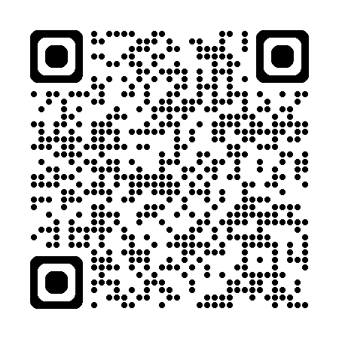
Free guide
Embracing neurodiversity in the workplace
https://mailchi.mp/aileencarson.com/embracing-neurodiversity

Slide 10
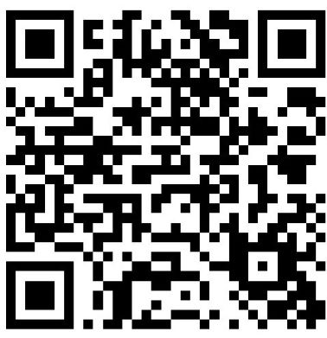
Contact me
Phone: 07952 964366
Email: aileen@aileencarson.com
Website: www.aileencarson.com
LinkedIn: https://www.linkedin.com/in/aileencarson/
Instagram: https://www.instagram.com/aileen_carson_coaching

