Slide 1
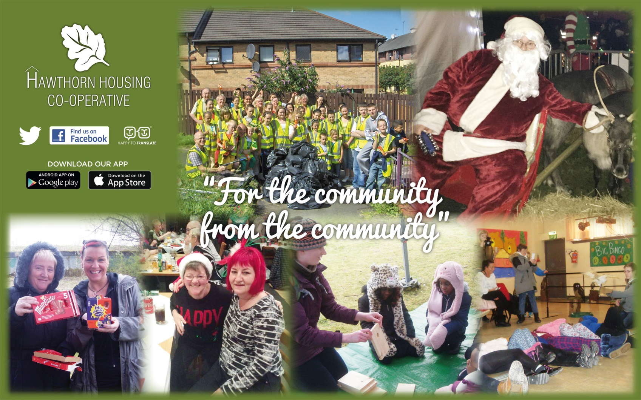
Hawthorn Housing Co-operative and Digital Inclusion

Slide 2
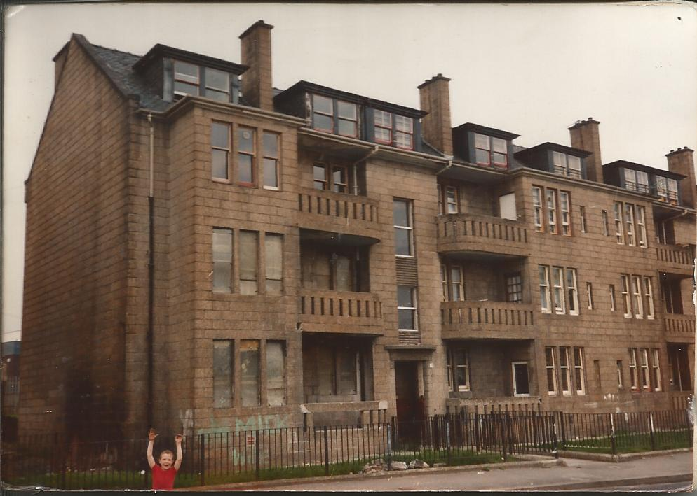
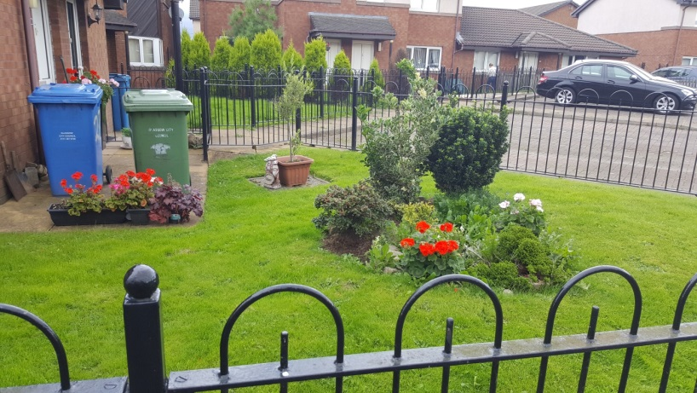
The plan
A bit of background
Our ‘Strategy’
What we have done
What we hope to do

Slide 3
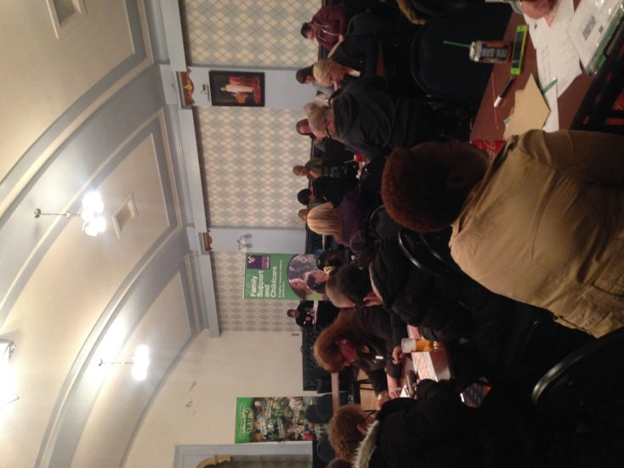
Hawthorn Housing Co-operative
Small
Compact
Possilpark
Very much community controlled
Close knit,
extended families,
but changing
Always been assessed as very deprived

Slide 4
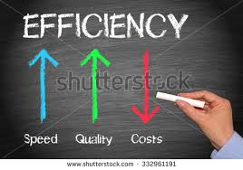
Our approach
3 strands
Improving our efficiency
‘Paperlight’
Committee
Improving communication with customers
Digital inclusion

Slide 5
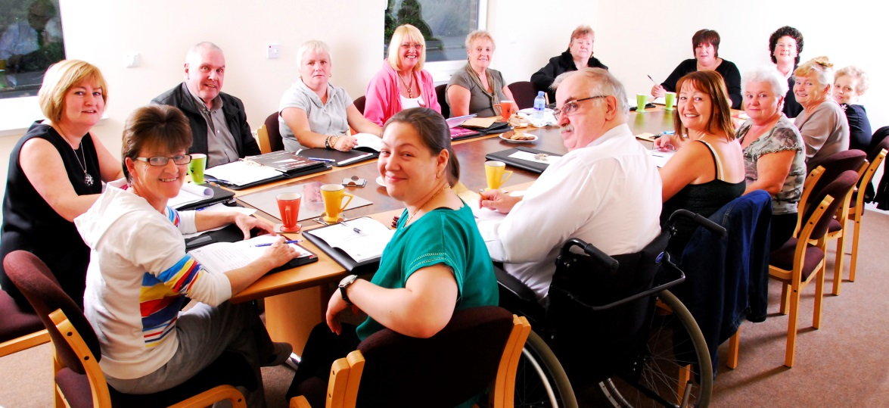
Improving our efficiency
Paperlight
Gradual rather than big bang
Allocations
House files
Opportunistic
Committee
Screen
Tablets

Slide 6
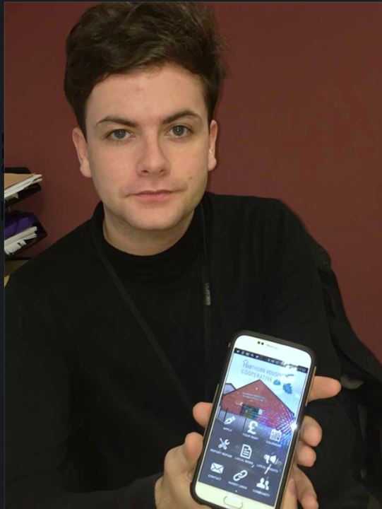
Communicating with Customers
Not all about social media
Noticeboards and talking
Some media better than others
Facebook
Phone app
Website
Twitter
Don’t just use it to tell people what you want them to know

Slide 7
Digital Inclusion – where we want to be
Always near bottom of deprivation indicators
Despite massive physical investment
Digital participation widening this gap
Could it be used to narrow the gap?
Big, easy to understand goal
Every household to have
Free internet
Free kit
Training

Slide 8
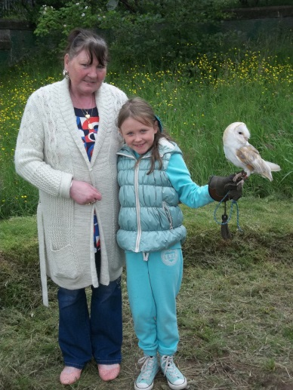
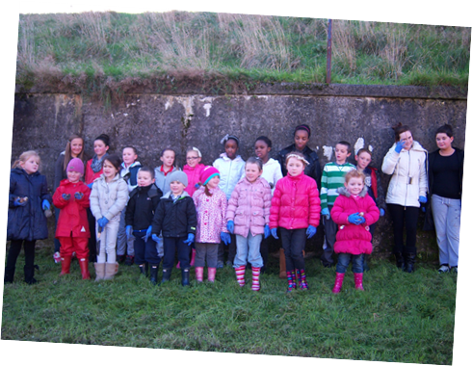
Digital inclusion – the benefits
Shopping
Save £500 a year [£160k]
Choice
Delivery
Savings on landline rental
£200 a year
Aspirations and opportunities
Jobs and benefits
Complaints
Empowering/directing resources
Family abroad
Fully participating in society

Slide 9
Digital Inclusion – Where we are at
Have a costed design
4mb of free broadband to every house
Have access to training
Identified the kit we would provide
Standard pack of tablet, 4mb broadband
and basic training
£230 a house
But, is it appropriate and access to funding

Slide 10
Digital inclusion – A step back
Support/advice from Scottish Government
Invest more time to inform proposal
Survey
will support applications for funding
To establish current use & raise awareness
Assist us to get it right
specifying
Ongoing support from Government
Small RSLs can have big ambitions
Ensure you have support in place
Caution can be healthy

